Slide 1
Attention Is All You Need

Slide 2
Introduction
Ongoing research efforts aim to enhance the capabilities of recurrent language models and encoderdecoder architectures.
Computation in recurrent models is typically factorized along symbol positions of input and output sequences, generating a sequence of hidden states ht based on previous hidden state 1 and input for position t.
The sequential nature of recurrent models limits parallelization within training examples, which is especially challenging for longer sequence lengths.
The alignment of positions to steps in computational time highlights the sequential nature of recurrent neural networks in processing input and producing output sequences.

Slide 3
Literature Review
Improved model performance using attention mechanisms
Attention mechanisms integral in sequence modeling and transduction tasks
Transformer model architecture relies entirely on attention mechanism
Proposes drawing global dependencies without recurrence

Slide 4
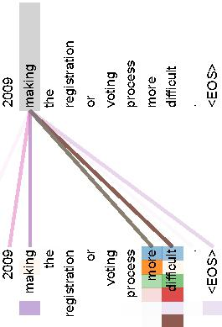
Literature Review

Slide 5
Methodology
The encoder consists of a stack of N identical layers, while the decoder includes a positionwise fully connected feedforward network.
To enable residual connections, all sublayers in the model and embedding layers produce outputs of dimension dmodel = 512.
The left and right halves of Figure 1 show the architectural layout of the Transformer with the encoder and decoder components.
The overall design of the Transformer architecture emphasizes the use of selfattention mechanisms and fully connected layers for effective information processing.

Slide 6
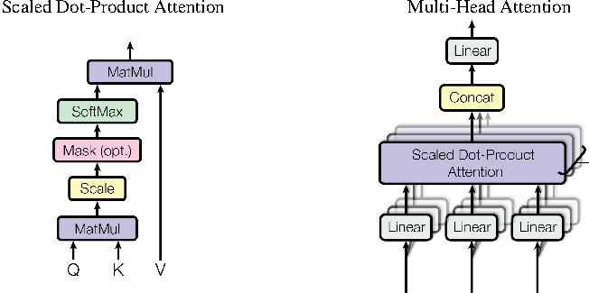
Methodology

Slide 7
Results
Heads demonstrate clear learning to perform different tasks

Slide 8
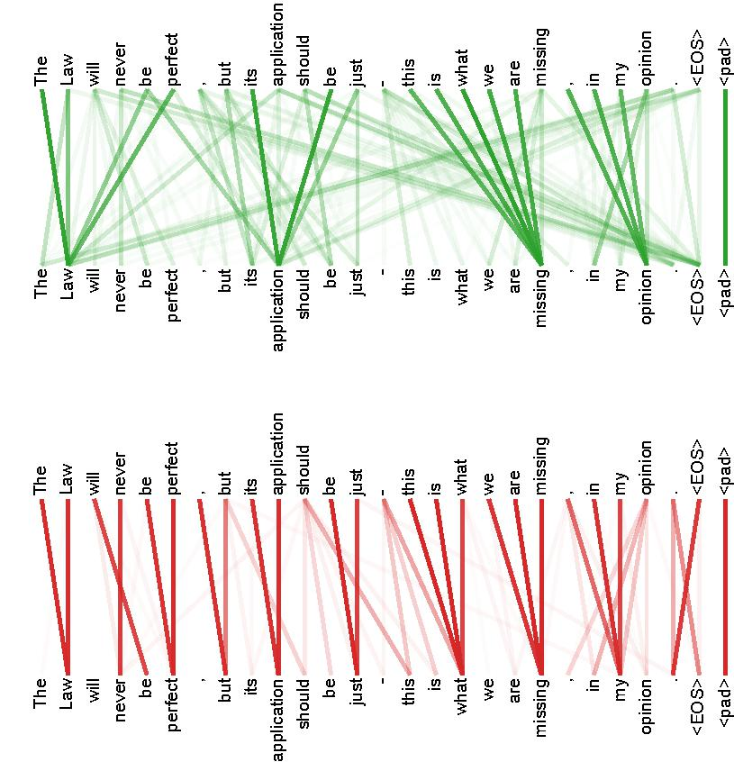
Results

Slide 9
Conclusion
Achieves stateoftheart score of 41.8 after training for 3.5 days on eight GPUs
Small fraction of training costs compared to best models from literature
Generalizes well to other tasks, successfully applied to English constituency parsing
Works well with both large and limited training data

